Slide 1
Simulated annealing
Resembles the annealing process used to cool metals slowly to reach an ordered (low-energy) state
Basic idea:
Allow “bad” moves occasionally, depending on “temperature”
High temperature => more bad moves allowed, shake the system out of its local minimum
Gradually reduce temperature according to some schedule
Sounds pretty flaky, doesn’t it?

Slide 2

Simulated annealing algorithm
function SIMULATED-ANNEALING(problem,schedule) returns a state
current ← problem.initial-state
for t = 1 to ∞ do
T ←schedule(t) if T = 0 then return current next ← a randomly selected successor of current
∆E ← next.value – current.value if ∆E > 0 then current ← next else current ← next only with probability e^{∆E/T}

Slide 3
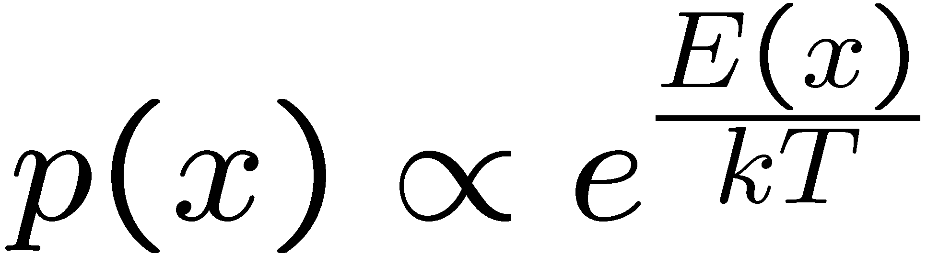
Simulated Annealing
Theoretical guarantee:
Stationary distribution (Boltzmann): P(x) α e^{E(x)/T}
If T decreased slowly enough, will converge to optimal state!
Proof sketch
Consider two adjacent states x, y with E(y) > E(x) [high is good]
Assume x→y and y→x and outdegrees D(x) = D(y) = D
Let P(x), P(y) be the equilibrium occupancy probabilities at T
Let P(x→y) be the probability that state x transitions to state y
x
y
Notes:
P(x)P(x->y) = P(y)P(y->x)
P(x)/D = P(y)exp((E(x)-E(y))/T)/D
P(x)/P(y) = exp(E(x)/T) / exp(E(y)/T)

Slide 4
Occupation probability as a function of T
E(x)
x

Slide 5
Simulated Annealing
Is this convergence an interesting guarantee?
Sounds like magic, but reality is reality:
The more downhill steps you need to escape a local optimum, the less likely you are to ever make them all in a row
“Slowly enough” may mean exponentially slowly
Random restart hillclimbing also converges to optimal state…
Simulated annealing and its relatives are a key workhorse in VLSI layout and other optimal configuration problems

Slide 6
Local beam search
Basic idea:
K copies of a local search algorithm, initialized randomly
For each iteration
Generate ALL successors from K current states
Choose best K of these to be the new current states
Or, K chosen randomly with
a bias towards good ones

Slide 7
Beam search example (K=4)
X
7
X
7
8
9
10
9
X
8
9
9
8
9
10
9
10
8
10
7
9
9
X
6
X
5
X
7
X
3
6
8
9
X
7
9

Slide 8
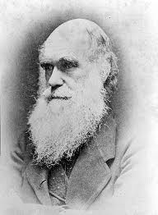
Local beam search
Why is this different from K local searches in parallel?
The searches communicate! “Come over here, the grass is greener!”
What other well-known algorithm does this remind you of?
Evolution!

Slide 9
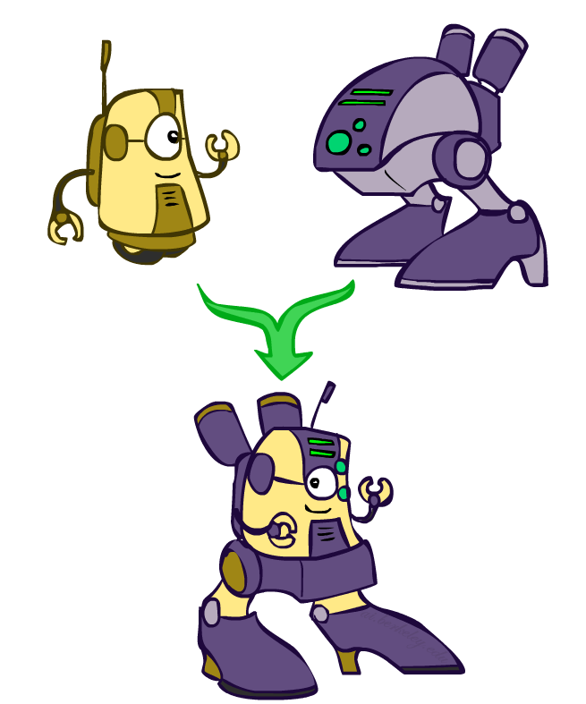
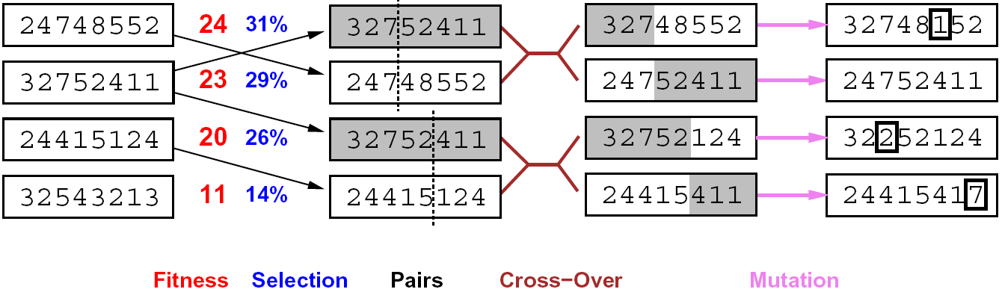
Genetic algorithms
Genetic algorithms use a natural selection metaphor
Resample K individuals at each step (selection) weighted by fitness function
Combine by pairwise crossover operators, plus mutation to give variety

Slide 10
Example: N-Queens
Does crossover make sense here?
What would mutation be?
What would a good fitness function be?

Slide 11

Local search in continuous spaces

Slide 12
Example: Siting airports in Romania
Place 3 airports to minimize the sum of squared distances from each city to its nearest airport
Airport locations
x = (x₁,y₁), (x₂,y₂), (x₃,y₃)
City locations (x_{c},y_{c})
C_{a} = cities closest to airport a
Objective: minimize
f(x) = Σ_{a} Σ_{c∈Ca} (x_{a} - x_{c})² + (y_{a} - y_{c})²

Slide 13
Handling a continuous state/action space
Discretize it!
Define a grid with increment δ , use any of the discrete algorithms
Choose random perturbations to the state
First-choice hill-climbing: keep trying until something improves the state
Simulated annealing
Compute gradient of f(x) analytically

Slide 14
Finding extrema in continuous space
Gradient vector ∇f(x) = (∂f/∂x₁, ∂f/∂y₁, ∂f/∂x₂, …)^{T}
For the airports, f(x) = Σ_{a} Σ_{c∈Ca} (x_{a} - x_{c})² + (y_{a} - y_{c})²
∂f/∂x₁ = Σ_{c∈C1} 2(x₁ - x_{c})
At an extremum, ∇f(x) = 0
Can sometimes solve in closed form: x₁ = (Σ_{c∈C1} x_{c})/|C₁|
Is this a local or global minimum of f?
Gradient descent: x ← x - α∇f(x)
Huge range of algorithms for finding extrema using gradients

Slide 15
Summary
Many configuration and optimization problems can be formulated as local search
General families of algorithms:
Hill-climbing, continuous optimization
Simulated annealing (and other stochastic methods)
Local beam search: multiple interaction searches
Genetic algorithms: break and recombine states
Many machine learning algorithms are local searches

Slide 16



CS 188: Artificial Intelligence
Propositional Logic I
Instructors: Stuart Russell and Peyrin Kao
University of California, Berkeley
Notes:
Please retain proper attribution and the reference to ai.berkeley.edu. Thanks!

Slide 17
Outline
Propositional Logic I
Basic concepts of knowledge, logic, reasoning
Propositional logic: syntax and semantics, Pacworld example
Propositional logic II
Inference by theorem proving (briefly) and model checking
A Pac agent using propositional logic

Slide 18
Agents that know things
Agents acquire knowledge through perception, learning, language
Knowledge of the effects of actions (“transition model”)
Knowledge of how the world affects sensors (“sensor model”)
Knowledge of the current state of the world
Can keep track of a partially observable world
Can formulate plans to achieve goals
Can design and build gravitational wave detectors…..

Slide 19
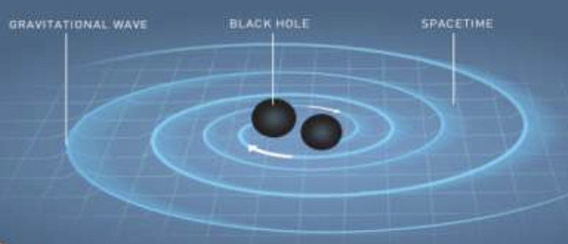
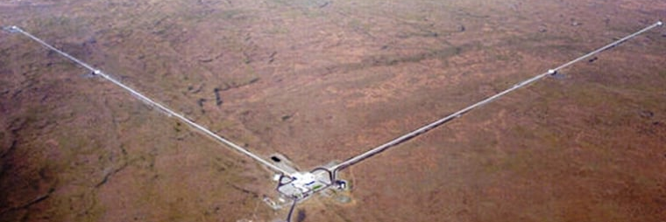
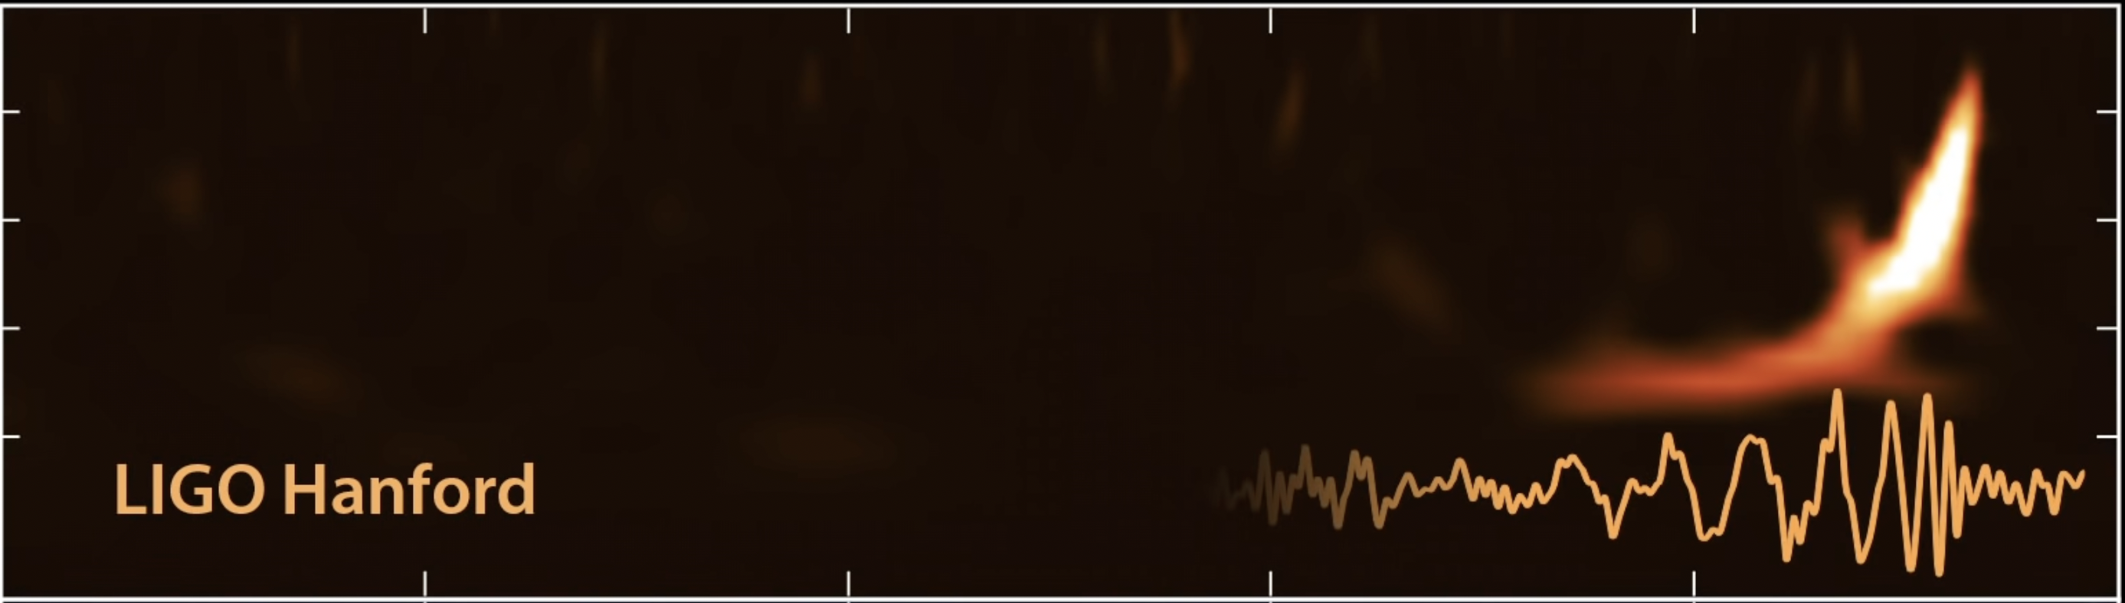
LIGO

Slide 20
Knowledge, contd.
Knowledge base = set of sentences in a formal language
Declarative approach to building an agent (or other system):
Tell it what it needs to know (or have it Learn the knowledge)
Then it can Ask itself what to do—answers should follow from the KB
Agents can be viewed at the knowledge level i.e., what they know, regardless of how implemented
A single inference algorithm can answer any answerable question
Knowledge base
Domain-specific facts
Inference engine
Generic code

Slide 21
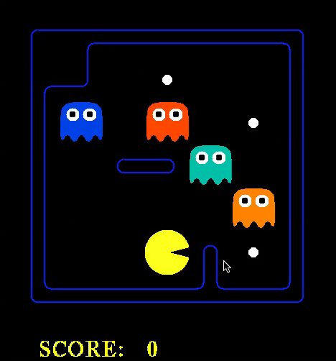

Slide 22

Logic
Syntax: What sentences are allowed?
Semantics:
What are the possible worlds?
Which sentences are true in which worlds? (i.e., definition of truth)
α₁
α₂
α₃
Syntaxland
Semanticsland

Slide 23
Different kinds of logic
Propositional logic
Syntax: P ∨ (¬Q ∧ R); X₁ ⇔ (Raining ⇒ ¬Sunny)
Possible world: {P=true,Q=true,R=false,S=true} or 1101
Semantics: α ∧ β is true in a world iff is α true and β is true (etc.)
First-order logic
Syntax: ∀x ∃y P(x,y) ∧ ¬Q(Joe,f(x)) ⇒ f(x)=f(y)
Possible world: Objects o₁, o₂, o₃; P holds for <o₁,o₂>; Q holds for <o₃>; f(o₁)=o₁; Joe=o₃; etc.
Semantics: φ(σ) is true in a world if σ=o_{j} and φ holds for o_{j}; etc.

Slide 24
Different kinds of logic, contd.
Relational databases:
Syntax: ground relational sentences, e.g., Sibling(Ali,Bo)
Possible worlds: (typed) objects and (typed) relations
Semantics: sentences in the DB are true, everything else is false
Cannot express disjunction, implication, universals, etc.
Query language (SQL etc.) typically some variant of first-order logic
Often augmented by first-order rule languages, e.g., Datalog
Knowledge graphs (roughly: relational DB + ontology of types and relations)
Google Knowledge Graph: 5 billion entities, 500 billion facts, >30% of queries
Facebook network: 2.93 billion people, trillions of posts, maybe quadrillions of facts

Slide 25
Inference: entailment
Entailment: α |= β (“α entails β” or “β follows from α”) iff in every world where α is true, β is also true
I.e., the α-worlds are a subset of the β-worlds [models(α) ⊆ models(β)]
In the example, α₂ |= α₁
(Say α₂ is ¬Q ∧ R ∧ S ∧ W
α₁ is ¬Q )
α₁
α₂

Slide 26
Inference: proofs
A proof is a demonstration of entailment between α and β
Sound algorithm: everything it claims to prove is in fact entailed
Complete algorithm: every that is entailed can be proved

Slide 27
Inference: proofs
Method 1: model-checking
For every possible world, if α is true make sure that is β true too
OK for propositional logic (finitely many worlds); not easy for first-order logic
Method 2: theorem-proving
Search for a sequence of proof steps (applications of inference rules) leading from α to β
E.g., from P and (P ⇒ Q), infer Q by Modus Ponens

Slide 28
Propositional logic syntax
Given: a set of proposition symbols {X₁,X₂,…, X_{n}}
(we often add True and False for convenience)
X_{i} is a sentence
If α is a sentence then ¬α is a sentence
If α and β are sentences then α ∧ β is a sentence
If α and β are sentences then α ∨ β is a sentence
If α and β are sentences then α ⇒ β is a sentence
If α and β are sentences then α ⇔ β is a sentence
And p.s. there are no other sentences!

Slide 29
Propositional logic semantics
Let m be a model assigning true or false to {X₁,X₂,…, X_{n}}
If α is a symbol then its truth value is given in m
¬α is true in m iff α is false in m
α ∧ β is true in m iff α is true in m and β is true in m
α ∨ β is true in m iff α is true in m or β is true in m
α ⇒ β is true in m iff α is false in m or β is true in m
α ⇔ β is true in m iff α ⇒ β is true in m and β ⇒ α is true in m

Slide 30
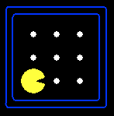
Example: Partially observable Pacman
Pacman knows the map but perceives just wall/gap to NSEW
Formulation: what variables do we need?
Wall locations
Wall_0,0 there is a wall at [0,0]
Wall_0,1 there is a wall at [0,1], etc. (N symbols for N locations)
Percepts
Blocked_W (blocked by wall to my West) etc.
Blocked_W_0 (blocked by wall to my West at time 0) etc. (4T symbols for T time steps)
Actions
W_0 (Pacman moves West at time 0), E_0 etc. (4T symbols)
Pacman’s location
At_0,0_0 (Pacman is at [0,0] at time 0), At_0,1_0 etc. (NT symbols)

Slide 31


How many possible worlds?
N locations, T time steps => N + 4T + 4T + NT = O(NT) variables
O(2^{NT}) possible worlds!
N=200, T=400 => ~10²⁴⁰⁰⁰ worlds
Each world is a complete “history”
But most of them are pretty weird!

Slide 32
Pacman’s knowledge base: Map
Pacman knows where the walls are:
Wall_0,0 ∧ Wall_0,1 ∧ Wall_0,2 ∧ Wall_0,3 ∧ Wall_0,4 ∧ Wall_1,4 ∧ …
Pacman knows where the walls aren’t!
¬Wall_1,1 ∧ ¬Wall_1,2 ∧ ¬Wall_1,3 ∧ ¬Wall_2,1 ∧ ¬Wall_2,2 ∧ …

Slide 33
Pacman’s knowledge base: Initial state
Pacman doesn’t know where he is
But he knows he’s somewhere!
At_1,1_0 ∨ At_1,2_0 ∨ At_1,3_0 ∨ At_2,1_0 ∨ …

Slide 34
Pacman’s knowledge base: Sensor model
State facts about how Pacman’s percepts arise…
<Percept variable at t> ⇔ <some condition on world at t>
Pacman perceives a wall to the West at time t if and only if he is in x,y and there is a wall at x-1,y
Blocked_W_0 ⇔ ((At_1,1_0 ∧ Wall_0,1) v
(At_1,2_0 ∧ Wall_0,2) v
(At_1,3_0 ∧ Wall_0,3) v …. )
4T sentences, each of size O(N)
Note: these are valid for any map

Slide 35
Pacman’s knowledge base: Transition model
How does each state variable at each time gets its value?
Here we care about location variables, e.g., At_3,3_17
A state variable X gets its value according to a successor-state axiom
X_t ⇔ [X_t-1 ∧ ¬(some action_t-1 made it false)] v
[¬X_t-1 ∧ (some action_t-1 made it true)]
For Pacman location:
At_3,3_17 ⇔ [At_3,3_16 ∧ ¬((¬Wall_3,4 ∧ N_16) v (¬Wall_4,3 ∧ E_16) v …)]
v [¬At_3,3_16 ∧ ((At_3,2_16 ∧ ¬Wall_3,3 ∧ N_16) v
(At_2,3_16 ∧ ¬Wall_3,3 ∧ N_16) v …)]

Slide 36
How many sentences?
Vast majority of KB occupied by O(NT) transition model sentences
Each about 10 lines of text
N=200, T=400 => ~800,000 lines of text, or 20,000 pages
This is because propositional logic has limited expressive power
Are we really going to write 20,000 pages of logic sentences???
No, but your code will generate all those sentences!
In first-order logic, we need O(1) transition model sentences
(State-space search uses atomic states: how do we keep the transition model representation small???)

Slide 37
A knowledge-based agent
function KB-AGENT(percept) returns an action
persistent: KB, a knowledge base
t, an integer, initially 0
TELL(KB, MAKE-PERCEPT-SENTENCE(percept, t))
action ← ASK(KB, MAKE-ACTION-QUERY(t))
TELL(KB, MAKE-ACTION-SENTENCE(action, t))
t←t+1
return action

Slide 38
Some reasoning tasks
Localization with a map and local sensing:
Given an initial KB, plus a sequence of percepts and actions, where am I?
Mapping with a location sensor:
Given an initial KB, plus a sequence of percepts and actions, what is the map?
Simultaneous localization and mapping:
Given …, where am I and what is the map?
Planning:
Given …, what action sequence is guaranteed to reach the goal?
ALL OF THESE USE THE SAME KB AND THE SAME ALGORITHM!!

Slide 40
Summary
One possible agent architecture: knowledge + inference
Logics provide a formal way to encode knowledge
A logic is defined by: syntax, set of possible worlds, truth condition
A simple KB for Pacman covers the initial state, sensor model, and transition model
Logical inference computes entailment relations among sentences, enabling a wide range of tasks to be solved

